Slide 1

JAVA
Programming Language
Logash Polina May-2022

Slide 2

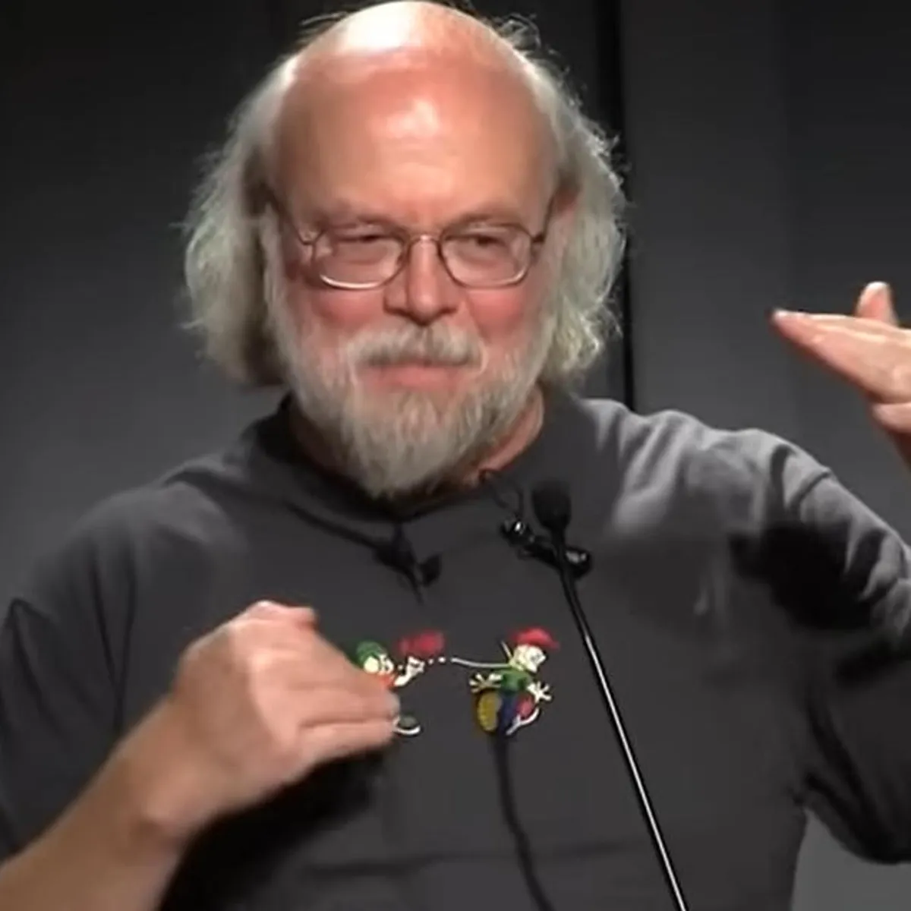


JAVA
simple
1991
powerfull
high-level
object oriented
James Gosling

Slide 3
JAVA Features
It is one of the easy-to-use programming languages to learn.
Write code once and run it on almost any computing platform.
Java is platform-independent. Some programs developed in one machine can be executed in another machine.
It is designed for building object-oriented applications.
It is a multithreaded language with automatic memory management.

Slide 4
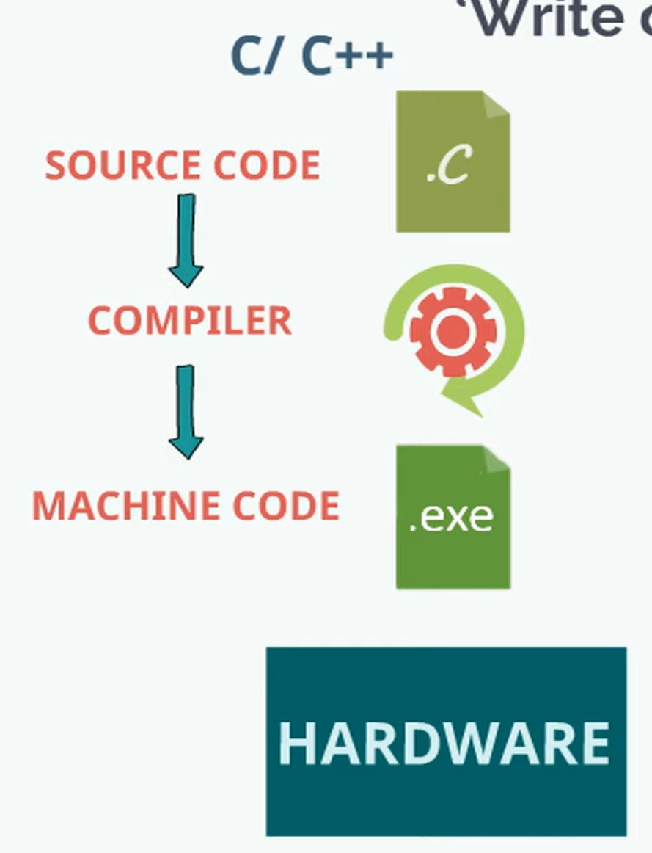
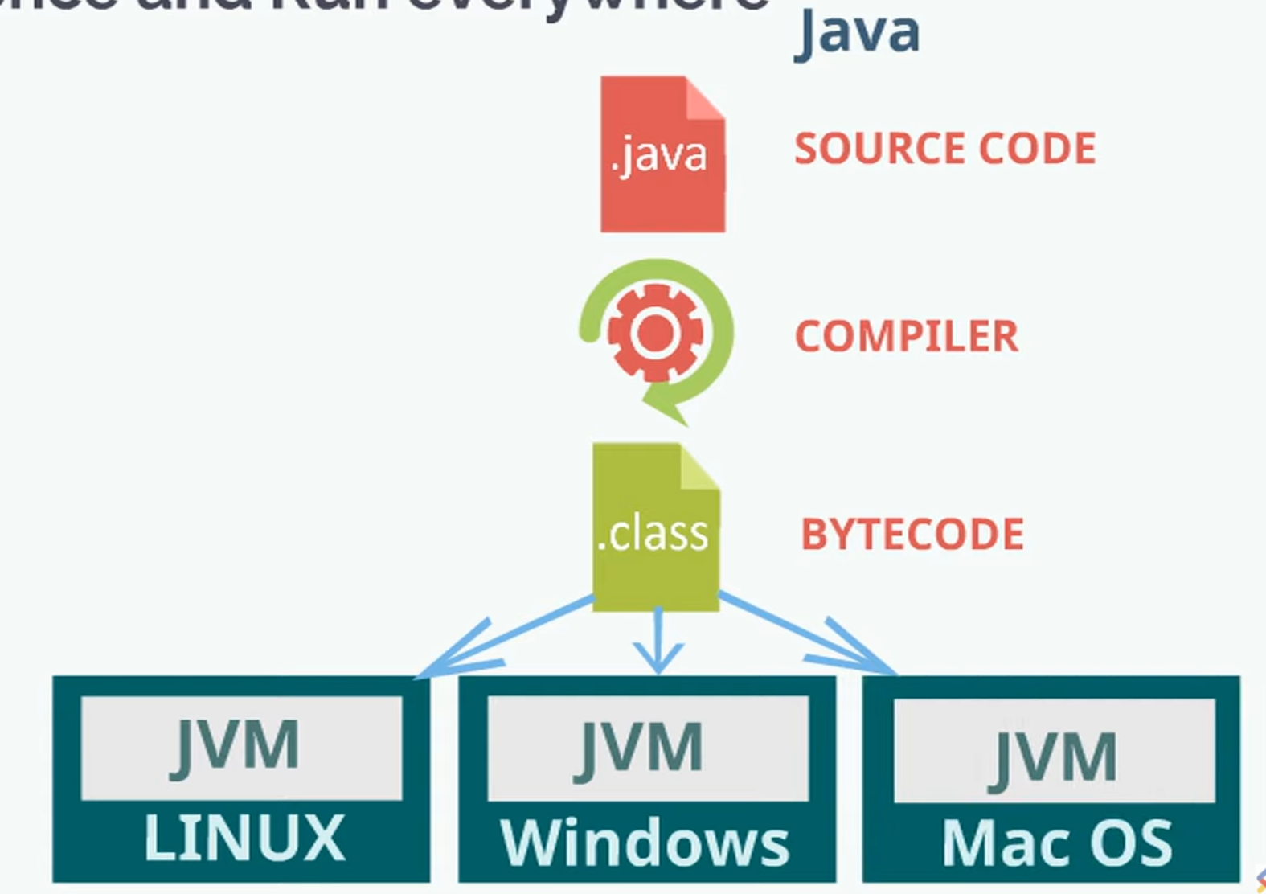

Slide 5
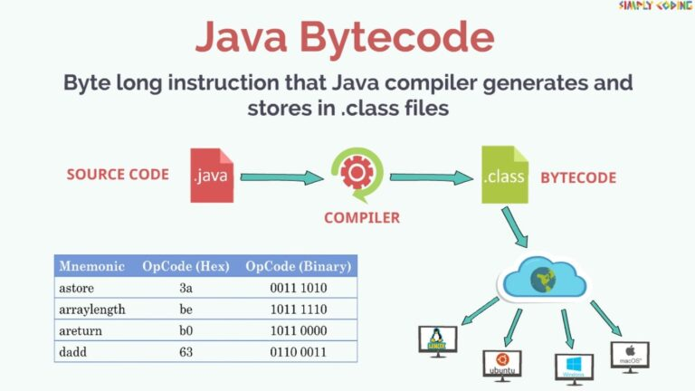

Slide 6
